Slide 1
Bodyfat Prediction
Presented by Group 2 Jiaming Zhou, Lijie Liu, Xiangan Zhang

Slide 2
Content
Background Research
Data Cleaning
Technical Methods
Result

Slide 3
Background Research
How much body fat percentage of a normal male should be?

Slide 4
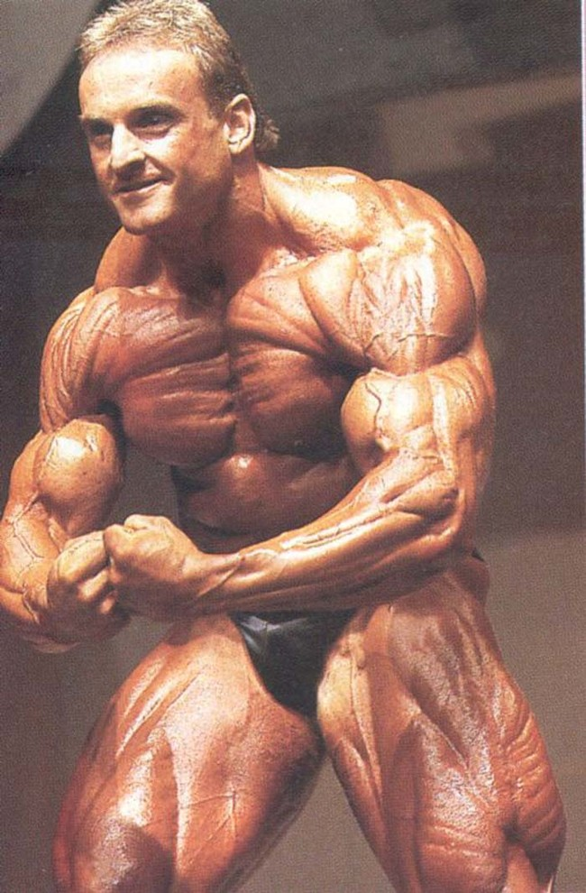
Andreas Münzer
Lowest body fat percentage ever
0.3%
lead to his painful death at only 31 years old

Slide 5
“You need body fat for cellular function, energy use and to pad the joints and organs. Having too little can lead to nutritional deficiencies, electrolyte imbalances and malfunction of the heart, etc.”
Carol Garber, professor of movement sciences at Columbia University

Slide 6
Men require at least 3 percent body fat and women at least 12 percent in order for the body to function properly.
Carol Garber
For women it is important to not go any lower than 10 to 13 percent body fat and men should go no lower than 2 to 5 percent body fat.
The American Council on Exercise

Slide 7
Data Cleaning

Slide 8
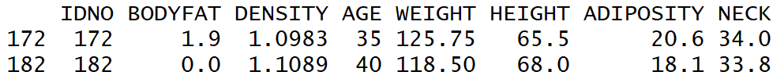
Data Cleaning

Slide 9
Data Cleaning
Check whether there is any input error
BMI = ADIPOSITY?

Slide 10
Data Cleaning
The height of person #42:
29.5 → 69.5
The weight of person #221:
153.25 → 173.25
The weight of person #42:
184.25 → 164.25

Slide 11
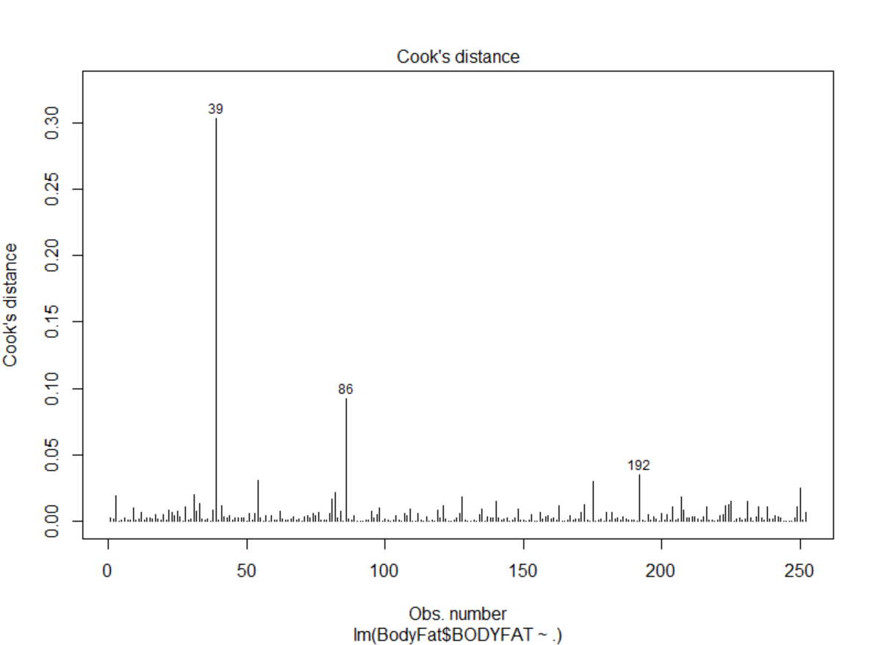
Data Cleaning

Slide 12
Data Cleaning

Slide 13
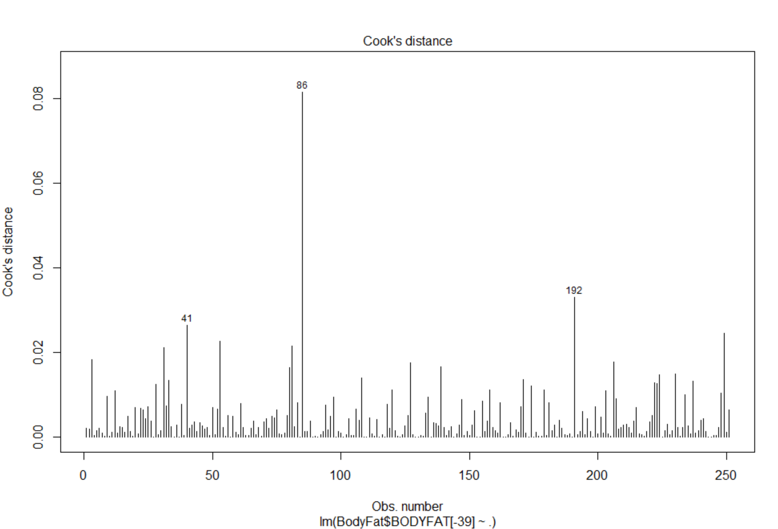
Data Cleaning

Slide 14
Data Cleaning
#86 is a tall but light guy.
#41 is a tall and heavy guy.
#192 is a tall and heavy guy.

Slide 15
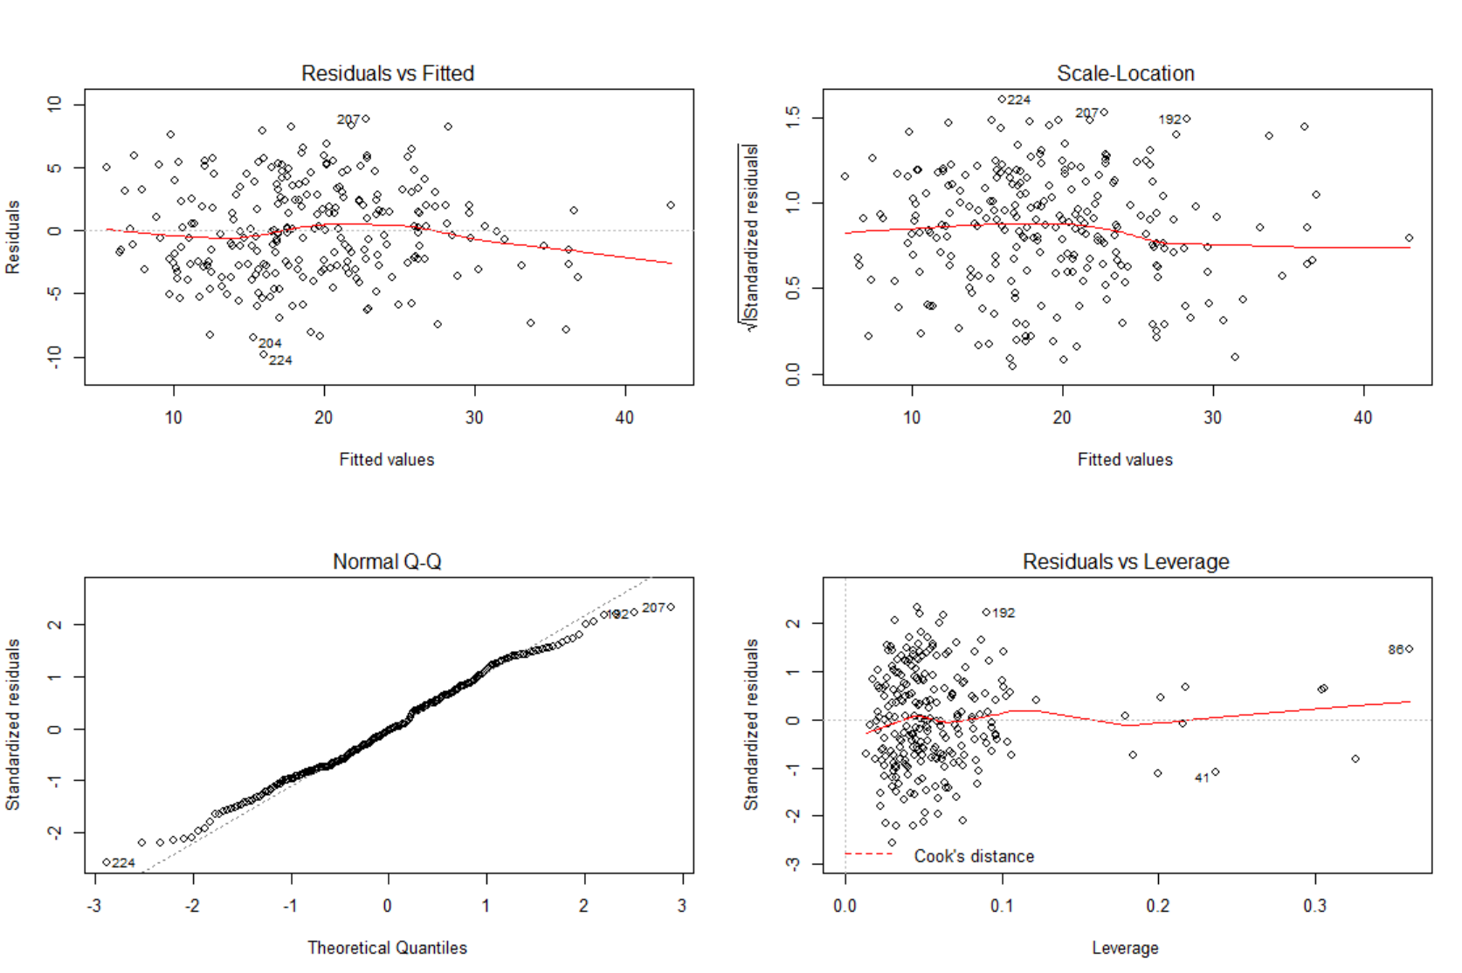
Data Cleaning

Slide 16
Data Cleaning
Remove 39,172,182

Slide 17
Technical Methods
Mallows's Cp
LASSO
Bidirectional selection

Slide 18
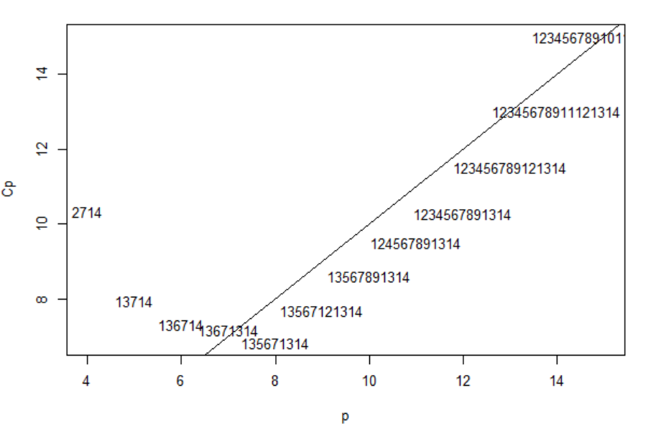
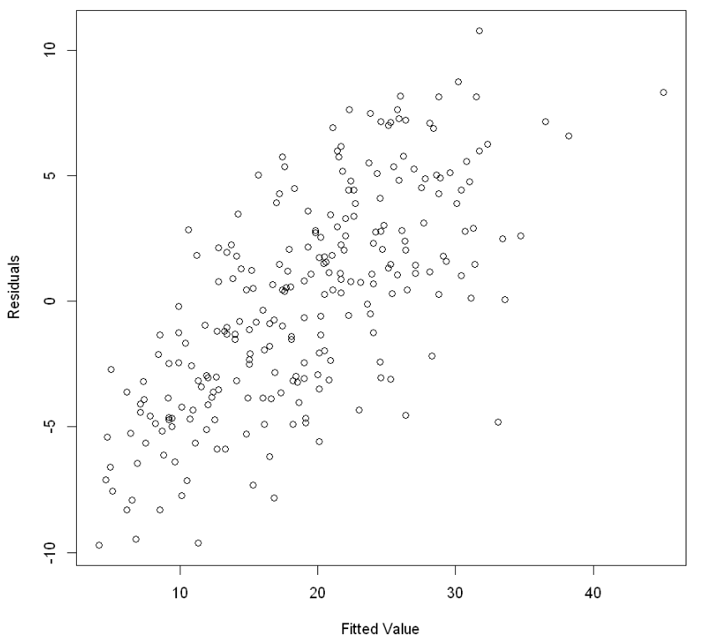
Technical Methods
Mallows’s CP
LASSO
Cannot handle complex collections of models as in the variable selection problem when the size of data is not large enough.
Hard to find a good trade-off between model complexity and goodness of fit.

Slide 19


Bidirectional selection
AIC
$$\text{B}\text{odyFat}\text{ \sim }\text{Age}\text{ + }\text{Weight}\text{ + }\text{Height}\text{ + }\text{Adiposity}\text{ + }\text{Neck}\text{ + }\text{Abdmen}\text{ + }\text{Hip}\text{ + }\text{Thigh}\text{ + }\text{Forearm}\text{+ }\text{Wrist}$$
BIC
$$BodyFat \sim θ_{0}+Weight\left(lb\right)+Abdomen\left(cm\right)+Wrist(cm)$$

Slide 20
Result

Slide 21
Rule-of-thumb Method
Bodyfat(%) = - 0.09*Weight(lb)
+ 0.89*Abdomen(cm)
- 1.33*Wrist(cm)
- 23.02
“Weight multiplied by -0.09, plus Abdomen multiplied by 0.89, minus Wrist multiplied by 1.33, minus 23.02.”

Slide 22
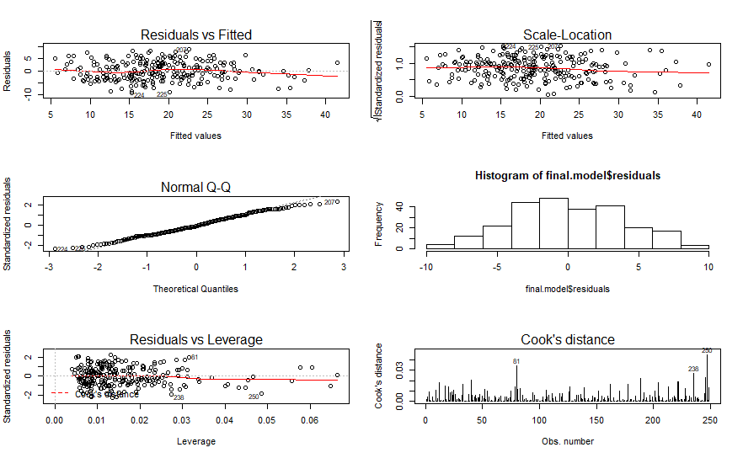
Diagnosing

Slide 23
Diagnosing and future work
VIF:
Weight Abdomen Wrist
5.547712 4.183954 2.033346

Slide 24
Diagnosing and future work
Pros:
simple, robust, easy to interpret

Slide 25
Diagnosing and future work
Cons:
Not satisfy normality based on qq plot

Slide 26
Diagnosing and future work
Future work:
Build a complex model
Feature engineering

